Slide 1
The database management mist.6030-201
Professor: Amit V. Deokar
Students: Sanjin Hodzic and Sridhar Rangan
The final Project: MIST.6030.201-FL-2018-Term-Project
Name of the project: “Global Computer Solutions (GCS)”
Date: December, 11 2018

Slide 2
The entities in the database
The entities in this database are as follows:
CUSTOMER – 6 records
EMPLOYEE – 30 records
REGION – 6 records
SKILL – 23 records
EMPSKILL (employee-skill associative entity) – 58 records
PROJECT – 1 record
PS (for project schedule/tasks) – 9 records
ASN (for assignment of an employee) – 13 records
WORKLOG (for work log) – 27 records
BILL – 1 record
TS (for task-skill associative entity) – 20 records

Slide 3
The screenshot of the tables in the database

Slide 4
Entity-relational model in Crow’s foot notation

Slide 5
SQL queries from Q. 9
Question 9
SELECT S.SKILL_ID,S.SKILL_DESCRIPTION,E.EMP_LNAME,E.EMP_FNAMEFROM SKILL AS S INNER JOIN EMPSKILL AS ES ON S.SKILL_ID = ES.SKILL_IDINNER JOIN EMPLOYEE AS E ON E.EMP_ID = ES.EMP_IDORDER BY S.SKILL_ID , E.EMP_LNAME ASC;

Slide 6
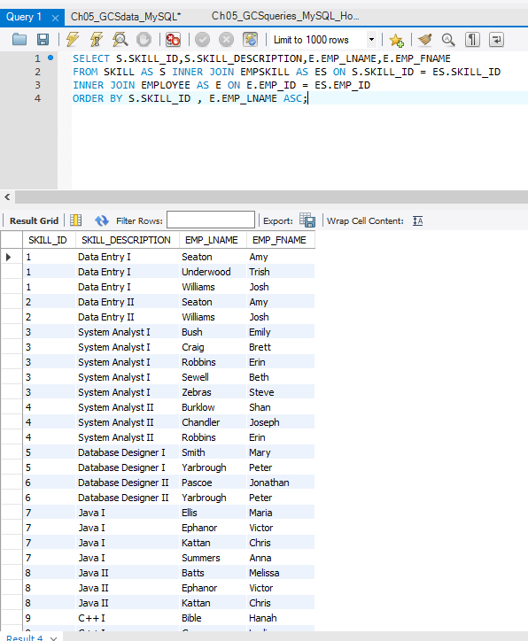

Slide 7
SQL queries from Q. 3
Question 3
SELECT REGION_NAME,SKILL_DESCRIPTION,ES.EMP_LNAME,ES.EMP_FNAME,EMP_HIREDATE
FROM EMPSKILL AS ES JOIN EMPLOYEE AS E ON ES.EMP_ID = E.EMP_ID
JOIN REGION AS R ON R.REGION_ID = E.REGION_ID
ORDER BY REGION_NAME, SKILL_DESCRIPTION, EMP_HIREDATE;

Slide 8
